Slide 1
ENSE 400
Bi-Weekly Scrum Report-Out
NotJustCode
Azeezat Lawal
Mfonisoabasi James
Shafiq Muhammad Ishraf Zainuddin
September 28, 2020

Slide 2
Project Deats
At NotJustCode, we decided to create the most fully featured recording application because we couldn’t quite find the perfect recording app to fit all our needs, such as:
Folders for different recordings, for example, a person could have their grocery list folder, a school folder, a music folder, and so on.
The ability to search for any recording within a specific folder or throughout the app.
Speeding up or slowing down a recording when playing it back.
The option to add more content to a pre-existing recording instead of creating a new one with the same subject matter.
Being able to cut out or edit parts of the recordings.
A text to speech feature which transcribes the recording.
So we decided to build an app with all these functionalities, and more.

Slide 3
Project & documentation review
What are you currently working on?
We are currently working on prototypes, lo/hi-fi, and interactive (using Balsamiq), as well as having discussions on the software we will be using and how we will be implementing our works.
Project Initiation
As mentioned above, we are creating the prototypes in order to make our implementation easier when we begin that process.
We have meetings twice a week (more if we need it), to discuss and complete the deliverables, and then move on to the actual
implementation work after the discussions.

Slide 4
Initial Constraints
Time & feature constraint: We may not be able to make the application fully featured at launch, given the time and other technological constraints. We hope to start out with a few key features, and slowly add-on to it over time to create our vision of a one-stop recorder that can do it all.
UI Constraints: We hope to find a perfect balance between features we know users would love and also something that is easy and simple to understand. We don’t want to create an app that requires a lot of explanation.
Programming language constraint: We would love for our application to be cross-platform, but we may end up having to start on one platform that is more easily accessible to us a team to build on, before
branching out to the others.

Slide 5
Project Execution
After completing our prototypes, we will begin implementing the work with the software of our choice, which is the Android Developer Studio. We have been going through different design iterations, and we will ultimately pick the best consistency for our design language and begin the work on implementation.

Slide 6
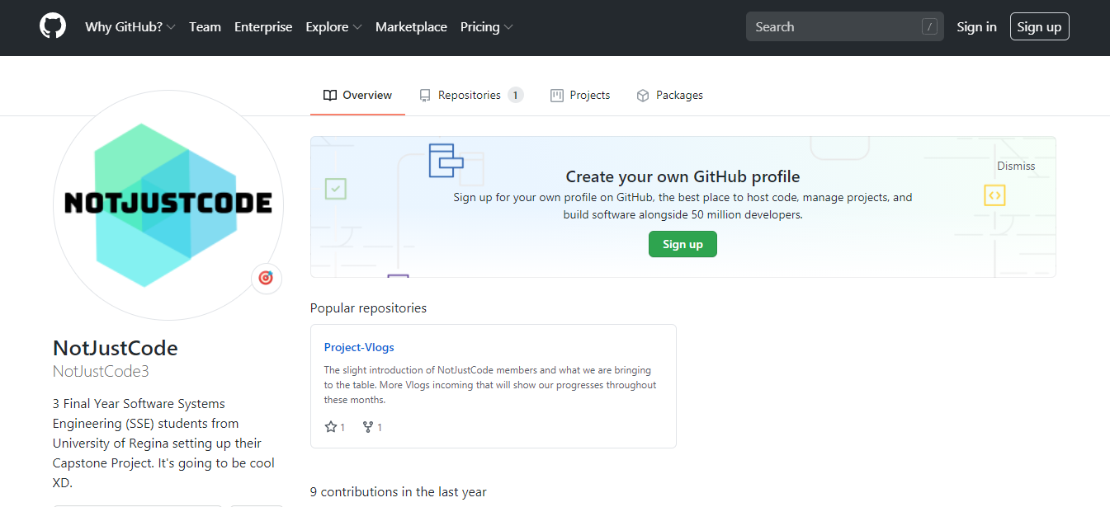
Github
Our Github is readable, usable, and we confirm its “goodness”.
https://github.com/NotJustCode3

Slide 7
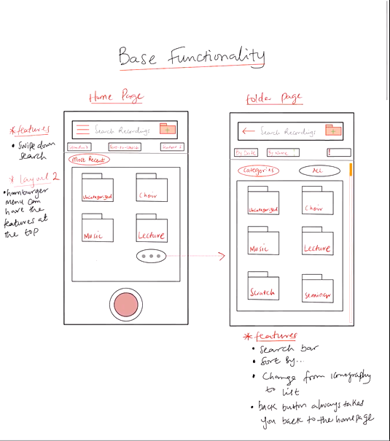
Project demo
https://github.com/NotJustCode3/Project_Vlogs/blob/master/Project%20Demo%20(Scrum%201).mp4

Slide 8
Group reflection
Do you feel you are on track?
There were couple of mishaps in figuring out some stuffs (utilities, techs,
meeting time, etc) but we still believe we are still on track.
Do you feel there are barriers to your success (if any)?
Timing is always the barriers (schedules differences, different task) but
as long as we strictly follow our schedule completing our goals, it would be ok.
We already have a lot of competitors even before we build our first prototype. There is a little bit of pressure, but we would
definitely can work through this.

Slide 9
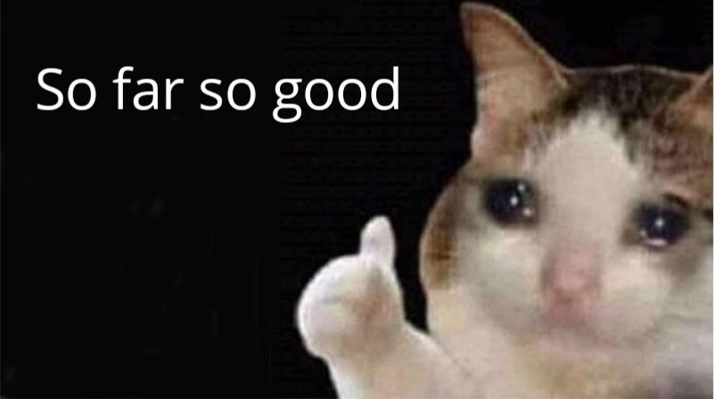
Group reflection
Do you need any help going forward?
Any other questions or concerns?
We are pondering the possibility of running some survey in order to find out more about our app functionality on the end-user side.
Notes:
Is it possible to have the opportunity to run some survey
in order to find out more about our app functionality on
the end-user side?

Slide 10
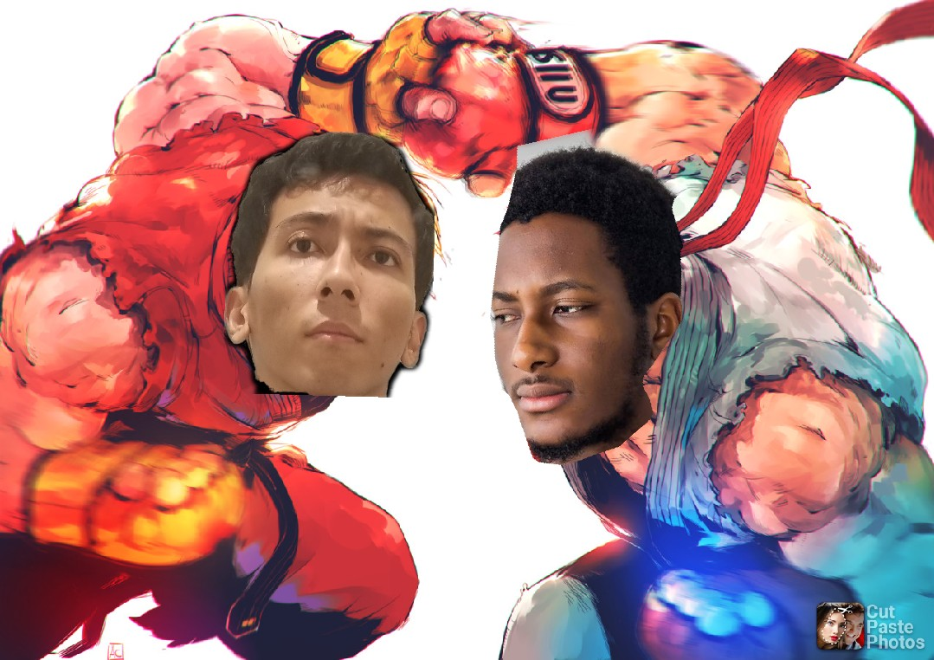
Any Questions?

Slide 11
Image Refs
Cofrancesco, Andrea. “Ryu vs Ken.” Street Fighter Encyclopedia, 2019, streefighterencyclopedia.blogspot.com/2019/05/ryu-vs-ken-by-andrea-confrancesco.html?m=1.
Sad cat, https://www.pinterest.se/pin/460070918185553954/

